Slide 1


Adaptive retail
Tailoring store experience
for improved performance and customer satisfaction

Slide 2

Our focus
Low Danish costumer satisfaction
This Photo by Unknown Author is licensed under CC BY-SA
Notes:
Traditional shops are facing increasing competition from online retail. There are, however multiple opportunities to improve the in-shop experience with:
- using the resources more effectively to reduce frustrations and save costs: 77% of shoppers are less likely to return to a store where they experienced long checkout lines and 19% of shoppers walk away, if the waiting line has more than 5 people in it.
- tailoring the customer journey to the needs of a specific person: Customers are often overloaded with choice and miss either personal assistence present in the smaller shops or online recommendations given by AI-assistans present in Amazon etc.

Slide 3
The adaptive retail
Computer Vision
Custom experience
Queue Optimization
Our solution!

Slide 4
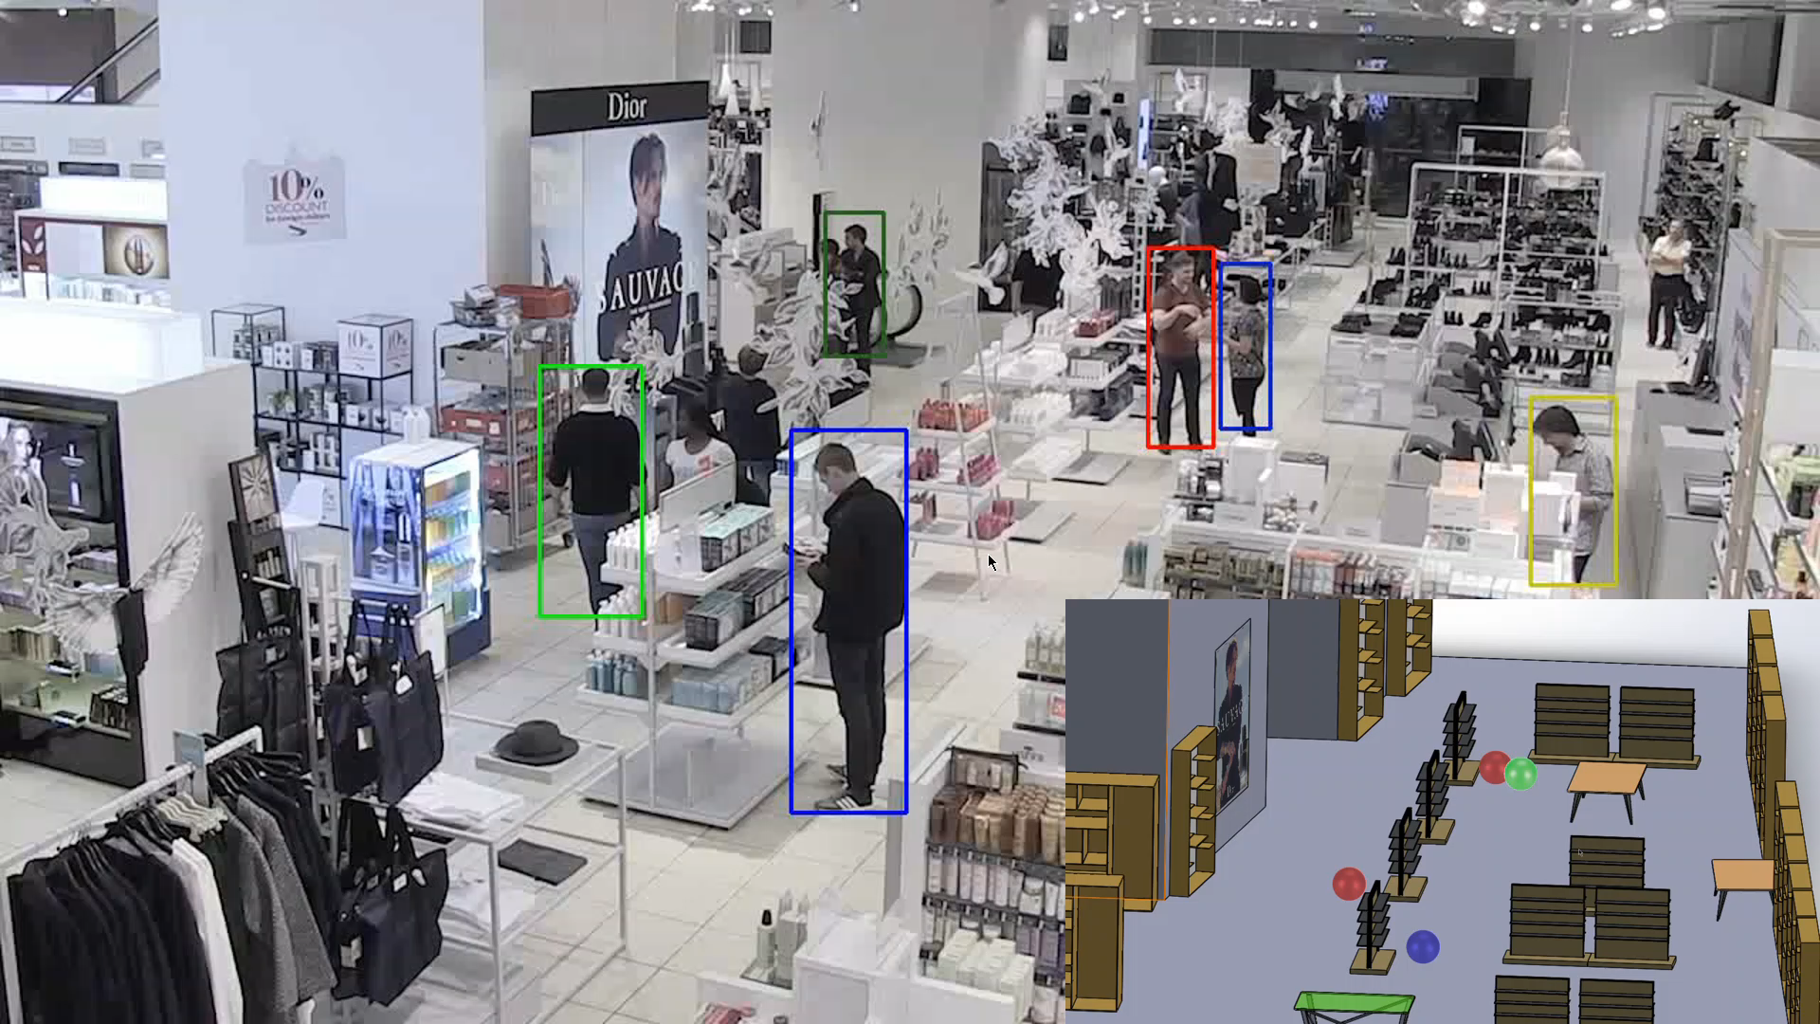
Computer Vision: - People tracking - Feature extraction

Slide 5
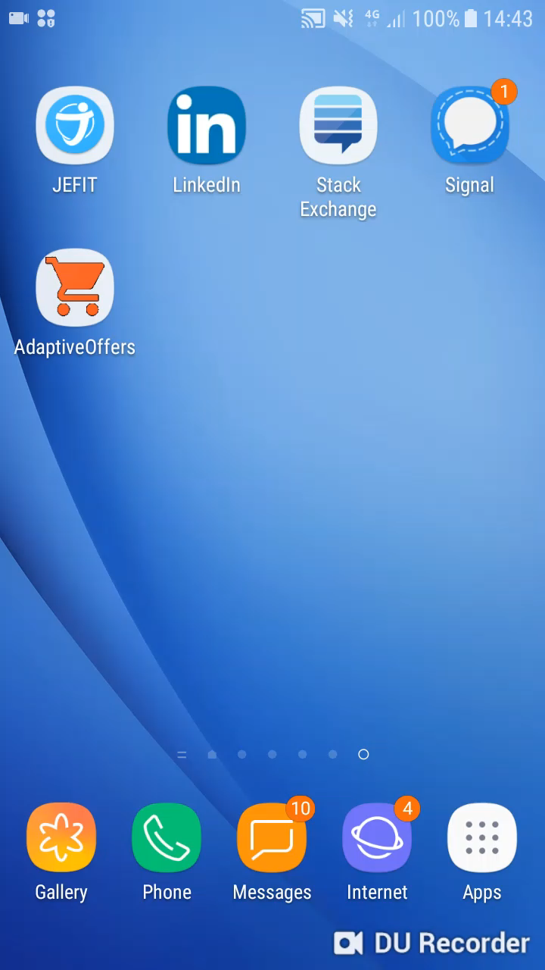
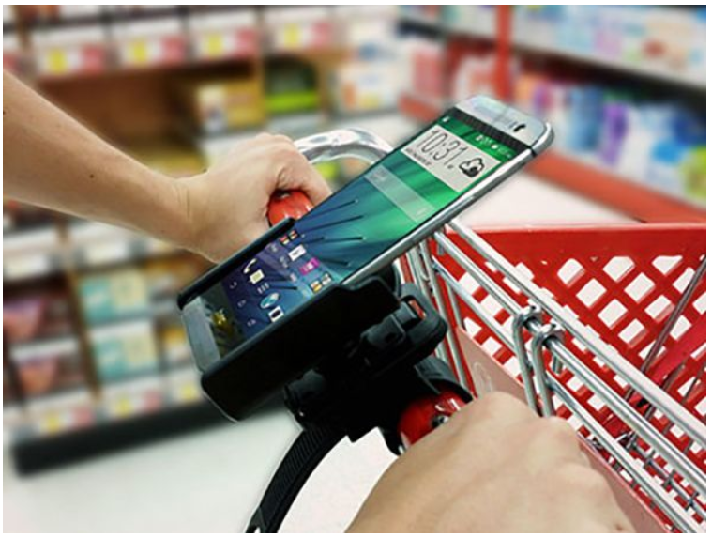
Custom App experience

Slide 6
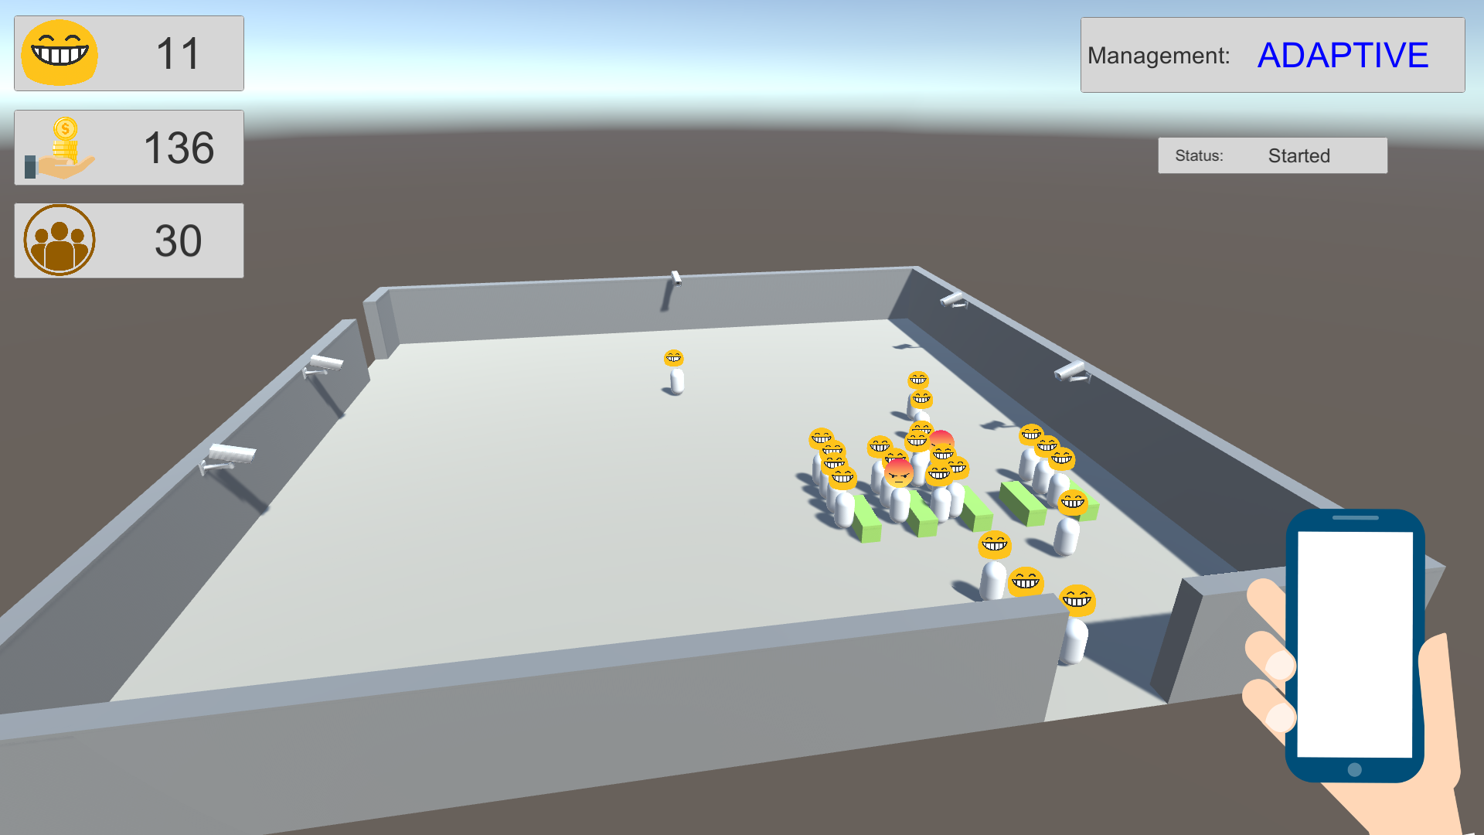
Queue Optimization
Live Demo
Notes:
Live Demo

Slide 7




Team
Piotr Milczarek
Jaume Alavedra
Jordi Gonzalez
Luka Locniskar

Slide 8
Conclusions

